Slide 1
Distributed Control and Automation Framework (DCAF)
Static Modules
Benjamin Celis, Simon Perez

Slide 2
Agenda
What Template to use
Static Module Creation
Script include
Parameters
Initialization

Slide 3
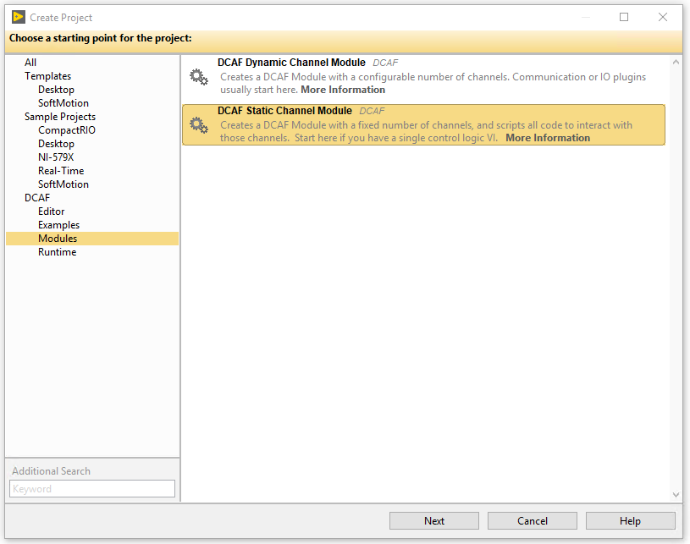
Static Or Dynamic?

Slide 4
Static or Dynamic
Static
Module developer defines the number of channels available in the module
Template includes UI ready to use.
Easier to Create
Mostly used for processing
Dynamic
Final user can configure the number of channels.
More flexible template
Requires more codding.
More commonly used for input/output

Slide 5
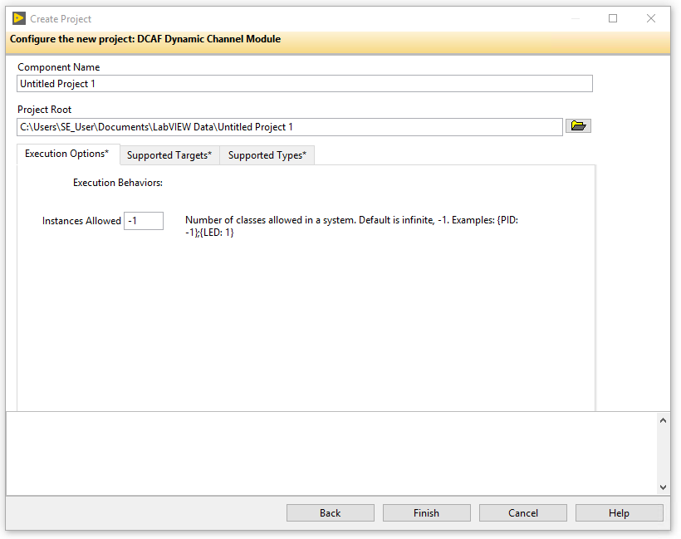
Defining the Channels
Engine
Input
Process
Output
Input
Process
Output
Input
Process
Output
Outside
Outside?
Outside

Slide 6
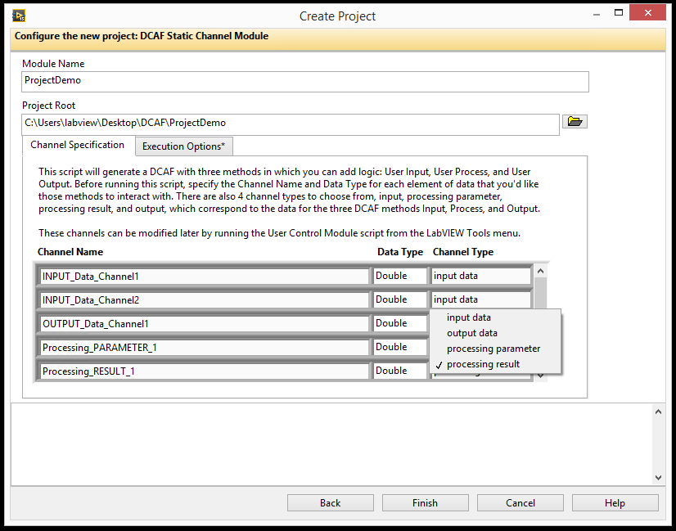
Creating a Static Module
Create Project through Template
Creates 3 main classes:
ModuleName configuration.lvlclass
ModuleName editor.lvlclass
ModuleName runtime.lvlclass

Slide 7
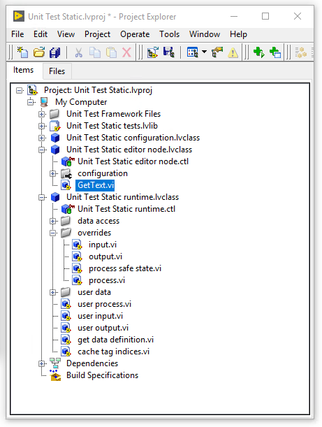
Static Module
Configuration Class:
Select module options (number of instances, allowable targets)
Update validate.vi with validation rules
Update get default error list.vi with default error classifications
Editor Class:
Select module glyph
Runtime
Implement User Input.vi, User Process.vi, and/or User Output.vi with custom logic

Slide 8
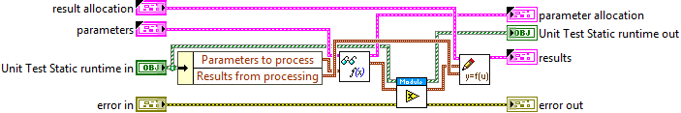
Process VI

Slide 9
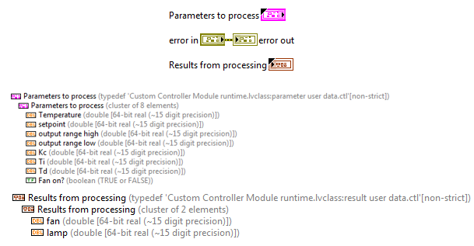
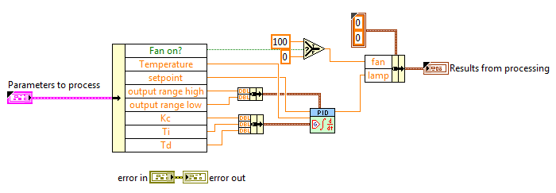
User Process

Slide 10
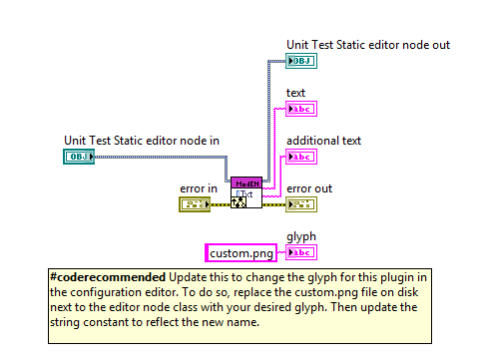
Get Text

Slide 11
Project 1
Custom PID
Channels :
Setpoint
Out
Choose Icon
Update User Process.
Channel | Data Type | Channel Type
Variable | Double | Process Parameter
Setpoint | Double | Process Parameter
Output | Double | Result

Slide 12
Exercise 1 Custom PID
Dev Guide 4.1

Slide 13
Exercise 1: Custom PID
Create module from template
Implement the user process
Test the user process

Slide 14
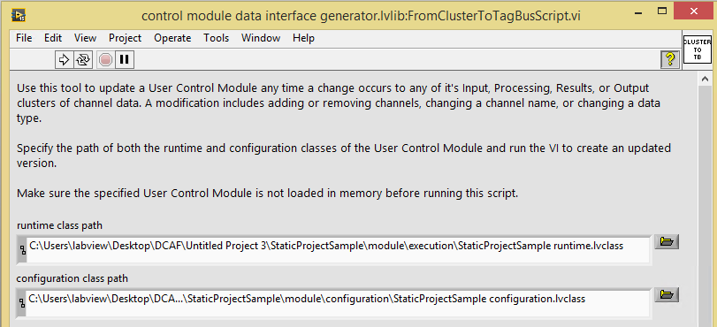
Scripting Utility
Need to update the channels?

Slide 15
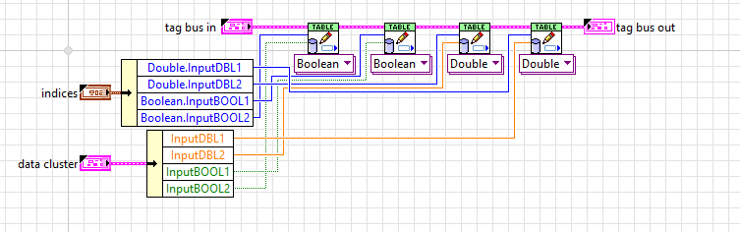
Scripting Utility

Slide 16
Project 1B
Custom PID
Channels :
Update User Process.
Channel | Data Type | Channel Type
Variable | Double | Process Parameter
Setpoint | Double | Process Parameter
Output | Double | Result
P | Double | Process Parameter
I | Double | Process Parameter
D | Double | Process Parameter

Slide 17
Exercise 2
Channel Scripting

Slide 18
Exercise 2: Channel Scripting
Update the clusters
Run the script
Channel | Data Type | Channel Type
Variable | Double | Process Parameter
Setpoint | Double | Process Parameter
Output | Double | Result
P | Double | Process Parameter
I | Double | Process Parameter
D | Double | Process Parameter

Slide 19
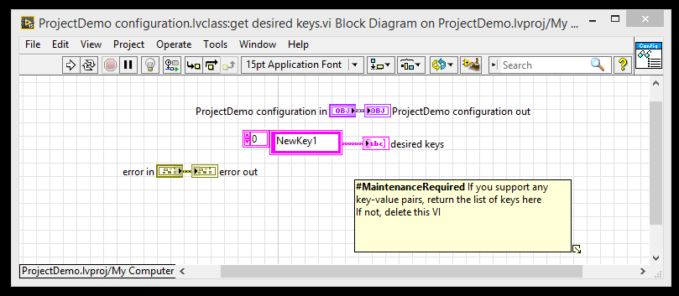
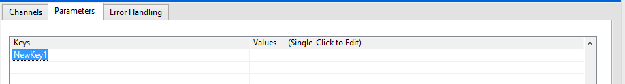
Static Module Checklist
To add a Key Value Pair, modify the get desired keys.vi
Modify the Apply Key Value Pairs.vi to do something with the data

Slide 20
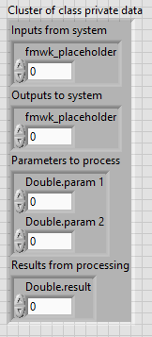
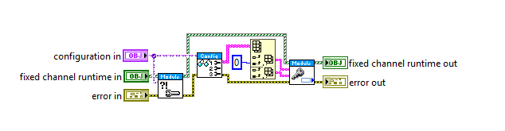
User Initialization

Slide 21
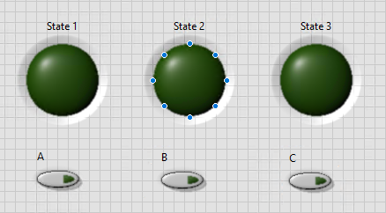
Project 2: State Machine
The starting State is defined in a Parameter
To switch from 1 to 2. Only A is True
To switch form 2 to 3 Only B is True
To switch from 3 to 1 Only C is True
State 1
State 2
State 3

Slide 22
Exercise 3 State Machine Module

Slide 23
Exercise 3: State Machine
Create module from template
Add the state to the runtime
Initialize the state
Implement the user process
Test the user process

Slide 24
Exercise 4 (optional)
Running the state machine in DCAF Engine
Notes:
In a DCAF engine use the UI module to interact with the state machine module.

Slide 25
Exercise 4: Running the state machine in DCAF Engine
Use the UI module to test 2 multiplexers in the runtime

Slide 26
Conclusions
Static Modules have their channels and parameters defined by the module developer
Create the Module from the Static Module
Add Parameters to set desired keys.vi (optional)
Handle initialization (optional)
Implement the Input, Processing, and/or Output Methods as needed
You should do testing and validation of your module (will be discussed in later chapters)

